Slide 1








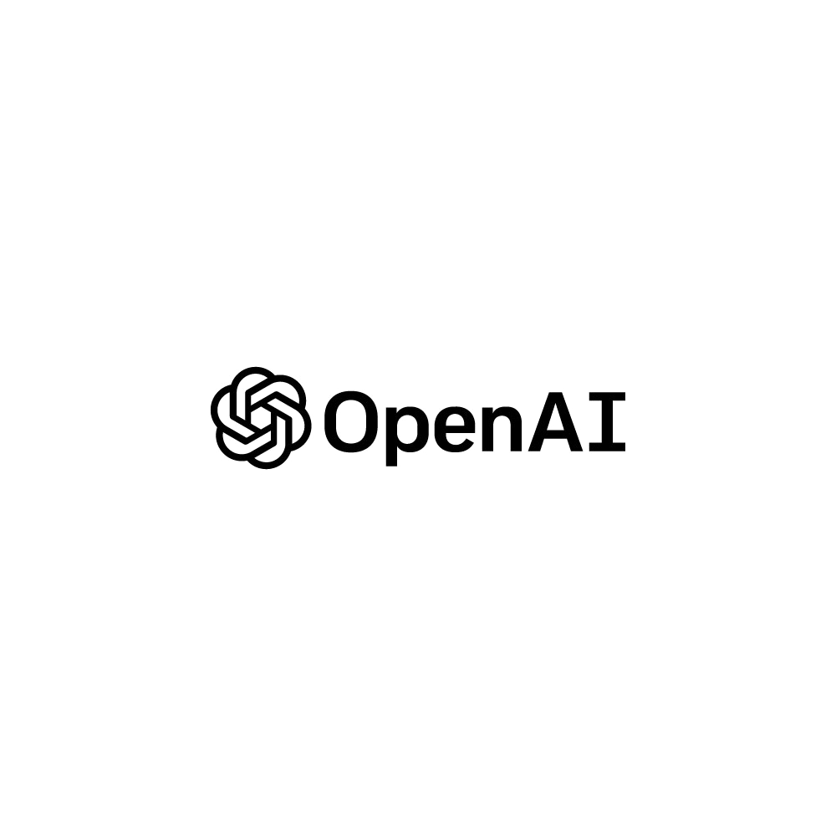





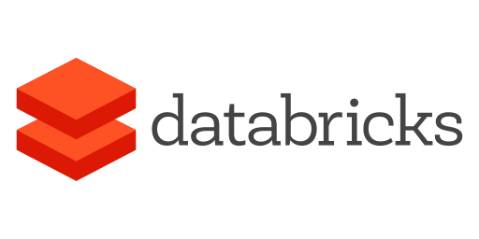
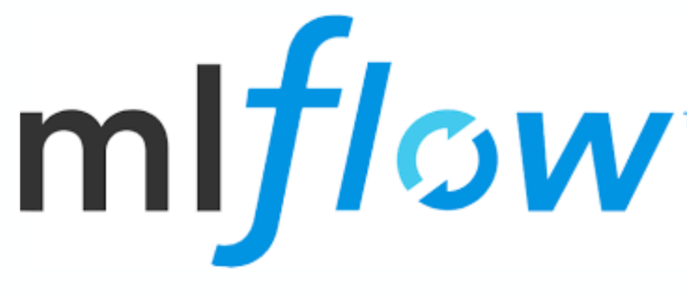
Case Study – Leading US-based Insurance Provider
Multi Agent Cyber Rating modifier - Enabling faster Underwriting
Background & Context
Solution Approach
Outcomes
Increasing cyber security risks calls for faster cyber underwriting across diverse market accounts.
Agentic AI has the capability to perform well in complex research situations.
Diverse and complex data sources enables opportunity to write even small/middle market accounts.
Leverage AI Agents to autonomous conduct research, plan and generate cyber risk assessment leveraging agentic web search and diverse data source
Developed an Agentic AI system from pilot to scale
Company Name
Multi source corroboration
Domain
Agentic Cyber rating System
Cyber risk Rating
Key Pain points
Underwriter
Faster underwriting
Manual account research: Manual research across scattered web sources for cyber ratings took days per submission.
Complex business rules : Complex business underwriting rules to analyze the accounts reduced efficiency.
Operational efficiency: Balancing the need for robust risk ratings while maintaining efficient and nimble Gen AI operations
Modifier rule
Global Insights
Increased efficiency
Notes:
NRG

Slide 2

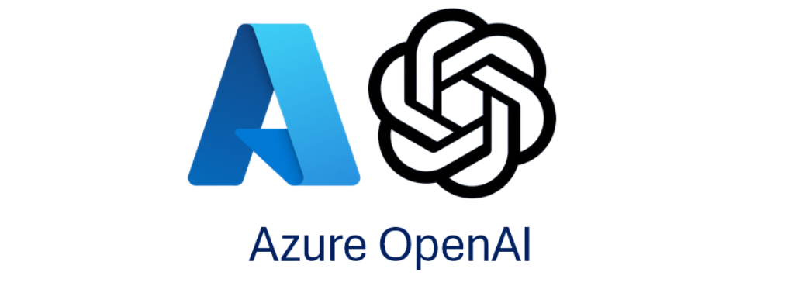


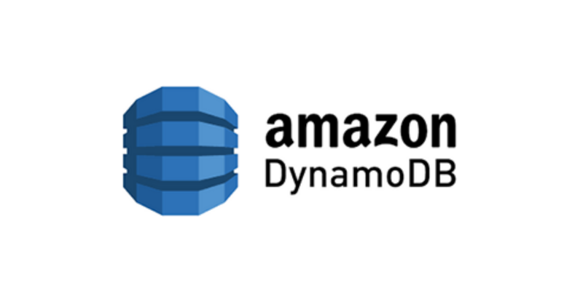





Case Study – Leading US-based Insurance Provider
Multi Agent Cyber Rating modifier - Enabling faster Underwriting
Agentic Stack
Key Learnings
AGENTS
Modular & Specialized Agent Design Enhances Efficiency: Streamline complex workflows by isolating responsibilities, simplify interactions, and improving task focus.
Observability and Continuous Learning: Persistent, structured data storage is foundational for traceability, iterative improvement, and transparency.
Feedback-driven Iteration is Critical for Quality Output: Integrating feedback induced reasoning loops ensures accuracy without compromising speed.
Supervisor Agent
Collector Agent
Coordinator Agent
Fact checker Agent
Underwriter Agent
TOOLS
Agentic web search
Stateful context
Guardrails
Bing Search
Dynamic routing
LLMs
Key Business Outcomes
AGENTIC FRAMEWORK
Optimization and Accuracy: Parallelization of agents for scaling effectively, full evidence lineage, smart cache with alias resolution and deployment with GitHub CI/CD.
Enhanced Efficiency: Improved task handling and dynamic workflow progression, faster iteration with parallel native data flow and batch execution.
Scalability and Flexibility: Configuration driven modifiers, complex information access with easy integration and containerization for API integration, and composability of agents.
Improved Observability and Feedback: Human escalation, entity mismatch rejection, human-in-the-loop, enhanced observability through MLFlow3.
DATA LAYER
Agent Shared Context
Caching
Json Exports
File system/logging
INFRA & OBSERVABILITY
AWS Lambda functions
Docker containerization
Notes:
NRG

